Slide 1

Final Capstone
Natural Language Processing (NLP) Recommender System for Travel Recommendations
Matthew Kehoe, February 2024

Slide 2
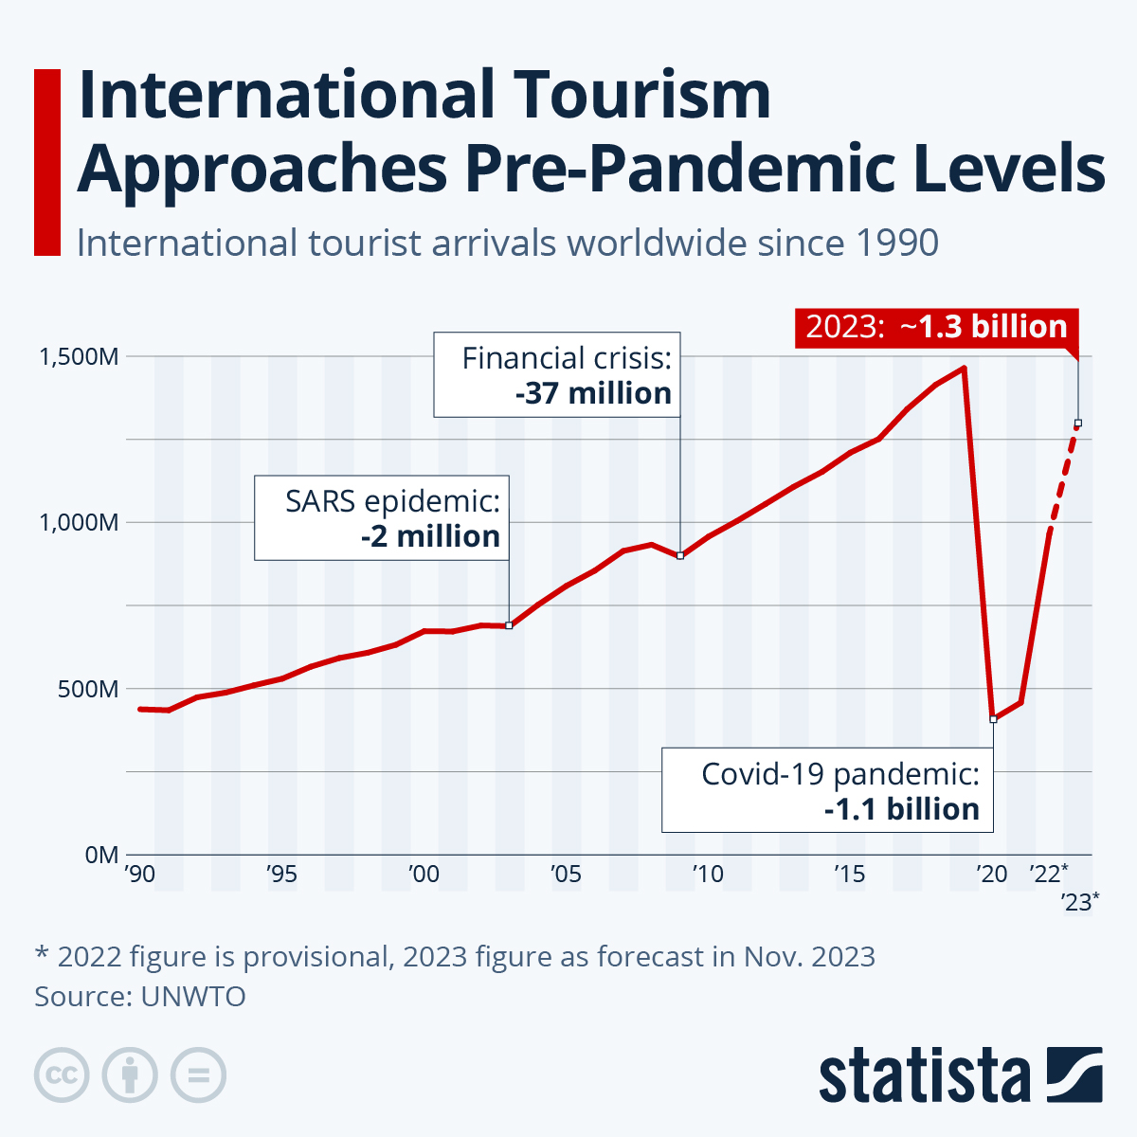
INTRODUCTION
The travel industry was heavily disrupted by the
COVID-19 pandemic.
With the development of vaccines, a lot of people
started to travel again.
In 2023, travel and tourism rebounded back to 2019
levels.

Slide 3
Project Aim and Detail
There are three parts of the project:
Scrape activities from 30 travel destinations in Trip Advisor.
Make an NLP recommender system to predict future travel destinations based on input text.
Create a Dash app to make personalized travel recommendations.

Slide 4
Part 1 – Web Scraping
• Used Beautiful Soup to scrape 56,109 activities from 30 destinations in Trip Advisor.
• 52,745 of the 56,109 activities are unique.
• I scraped up to 3,000 activities at the 30 travel destinations.

Slide 5
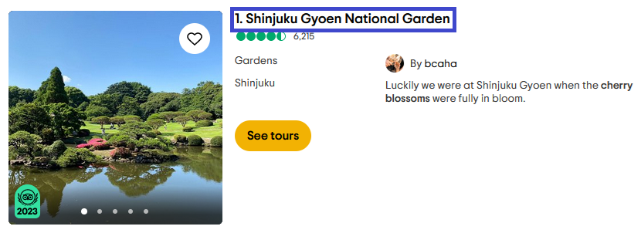
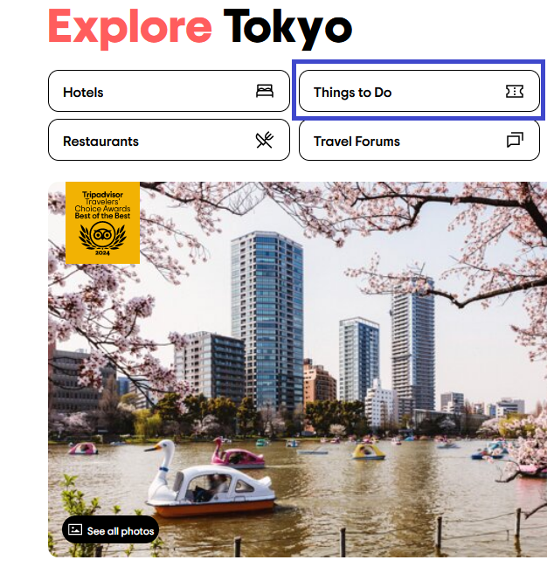
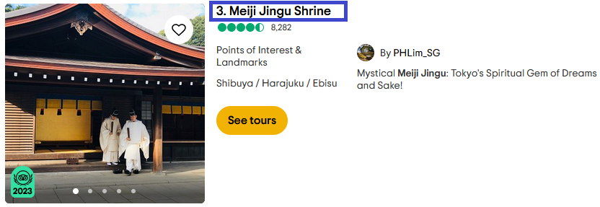
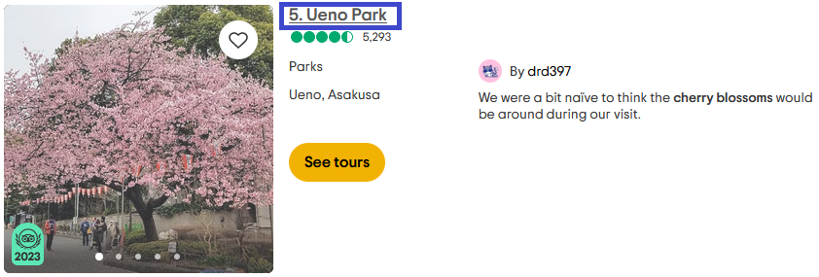
Tokyo, Japan

Slide 6
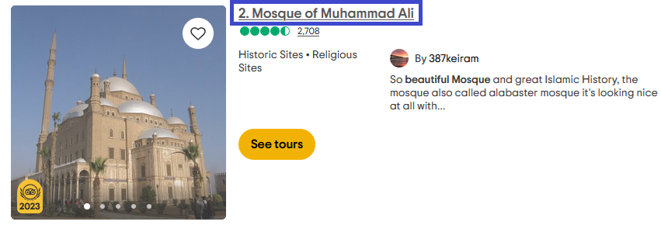
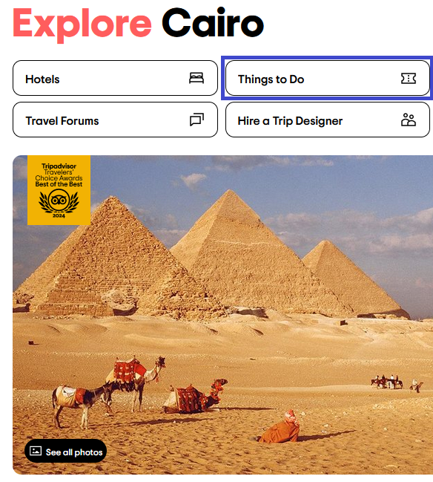
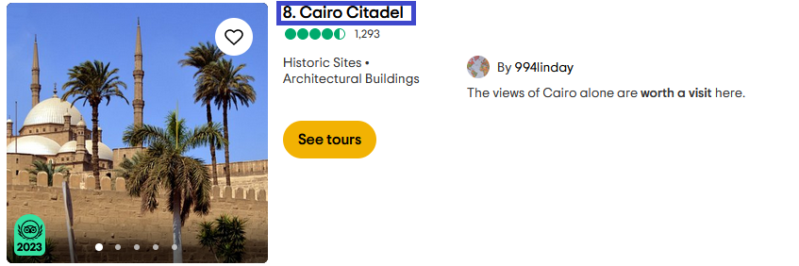
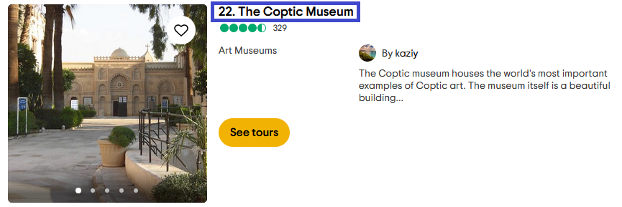
Cairo, Egypt

Slide 7
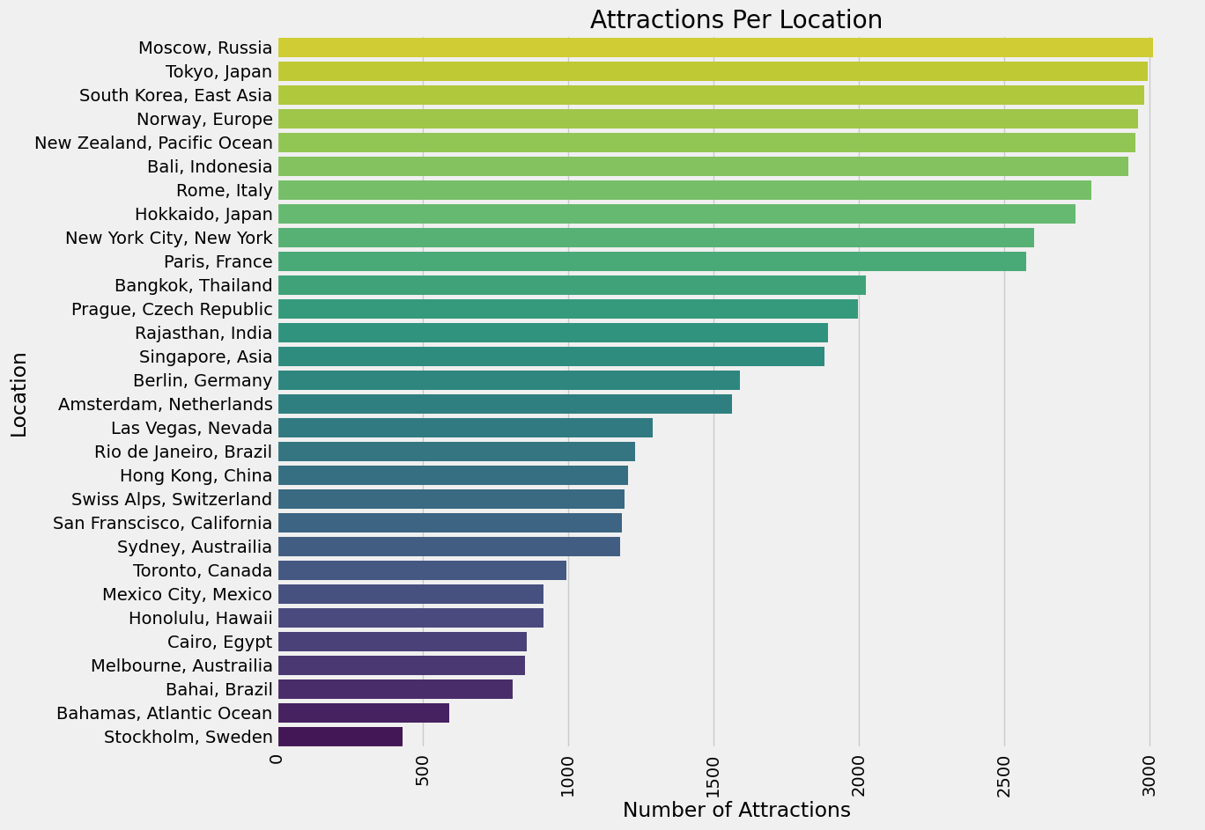
Data

Slide 8
Part 2 – NLP Recommender System
• I first established a baseline using a Naïve Bayes estimator.
• 52,745 of the 56,109 activities are unique.
• I scraped up to 3,000 activities at the 30 travel destinations.

Slide 9
CONCLUSION
• The images for the COVID-19 chest xrays were classified and evaluated with test data to get 92% test accuracy.
• The positive cases of New York are continuing to increase at least for the next 30 days.
• The positive cases for Illinois are increasing on a higher rate, all the other states are expected a mild increase for the next 10 days.
• Washington State has the highest recovery rate as of May 12.

Slide 10
THANK YOU!

